Slide 1
Manage Azure subscriptions and resources (15-20%)
Manage Azure subscriptions
• assign administrator permissions
• configure cost center quotas and tagging
• configure Azure subscription policies at Azure subscription level
Analyze resource utilization and consumption
• configure diagnostic settings on resources
• create baseline for resources
• create and test alerts
• analyze alerts across subscription
• analyze metrics across subscription
• create action groups and action rules
• monitor for unused resources
• monitor spend
• report on spend
• utilize Log Search log queries in Azure Monitory functions
• view alerts in Log Analytics Azure Monitor

Slide 2
Manage Azure subscriptions and resources (15-20%) (Continued)
Manage resource groups
• use Azure policies for resource groups
• configure resource locks
• configure resource policies
• implement and set tagging on resource groups
• move resources across resource groups
• remove resource groups
Managed role based access control (RBAC)
• create a custom role
• configure access to Azure resources by assigning roles
• configure management access to Azure
• troubleshoot RBAC
• implement RBAC policies
• assign RBAC Roles

Slide 3
Implement and manage storage (15-20%)
Create and configure storage accounts
• configure network access to the storage account
• create and configure storage account
• generate shared access signature
• install and use Azure Storage Explorer
• manage access keys
• monitor activity log by using Log Analytics Monitor Logs
• implement Azure storage replication
• Implement Azure AD Authentication
Import and export data to Azure
• create export from Azure job
• create import into Azure job
• use Azure Data Box
• configure and use Azure blob storage
• configure Azure content delivery network (CDN) endpoints
• use Azure Data Factory to transfer data to Azure

Slide 4
Implement and manage storage (15-20%) (Continued)
Configure Azure files
• create Azure file share
• create Azure File Sync service
• create Azure sync group
• troubleshoot Azure File Sync
Implement Azure backup
• configure and review backup reports
• perform backup operation
• create Recovery Services Vault
• create and configure backup policy
• perform a restore operation

Slide 5
Deploy and manage virtual machines (VMs) (15-20%)
Create and configure a VM for Windows and Linux
• configure high availability
• configure monitoring, networking, storage, and virtual machine size
• deploy and configure scale sets
Automate deployment of VMs
• modify Azure Resource Manager (ARM) template
• configure location of new VMs
• configure VHD template
• deploy from template
• save a deployment as an ARM template
• deploy Windows and Linux VMs

Slide 6
Deploy and manage virtual machines (VMs) (15-20%) (Continued)
Manage Azure VM
• add data discs
• add network interfaces
• automate configuration management by using PowerShell Desired State Configuration (DSC) and VM Agent by using custom script extensions
• manage VM sizes
• move VMs from one resource group to another
• redeploy VMs
• soft delete for Azure VMs
Manage VM backups
• configure VM backup; define backup policies; implement backup policies; perform VM restore; Azure Site Recovery

Slide 7
Configure and manage virtual networks (30-35%)
Create connectivity between virtual networks
• create and configure VNET peering
• create and configure VNET to VNET connections
• verify virtual network connectivity
• create virtual network gateway
Implement and manage virtual networking
• configure private and public IP addresses, network routes, network interface, subnets, and virtual network
Configure name resolution
• configure Azure DNS
• configure custom DNS settings
• configure private and public DNS zones

Slide 8
Configure and manage virtual networks (30-35%) (Continued)
Create and configure a Network Security Group (NSG)
• create security rules
• associate NSG to a subnet or network interface
• identify required ports
• evaluate effective security rules
• implement Application Security Groups
Implement Azure load balancer
• configure internal load balancer
• configure load balancing rules
• configure public load balancer
• troubleshoot load balancing
Monitor and troubleshoot virtual networking
• monitor on-premises connectivity
• use Network resource monitoring
• use Network Watcher
• troubleshoot external networking
• troubleshoot virtual network connectivity

Slide 9
Configure and manage virtual networks (30-35%) (Continued)
Integrate on premises network with Azure virtual network
• create and configure Azure VPN Gateway
• create and configure site to site VPN
• configure Express Route
• verify on premises connectivity
• troubleshoot on premises connectivity with Azure
• use Azure network adapter

Slide 10
Manage identities (15-20%)
Manage Azure Active Directory (AD)
• add custom domains
• azure AD Join
• configure self-service password reset
• manage multiple directories
Manage Azure AD objects (users, groups, and devices)
• create users and groups
• manage user and group properties
• manage device settings
• perform bulk user updates
• manage guest accounts
Implement and manage hybrid identities
• install Azure AD Connect, including password hash and pass-through synchronization
• use Azure AD Connect to configure federation with on-premises Active Directory Domain Services (AD DS)
• manage Azure AD Connect
• manage password sync and password writeback

Slide 11
Manage identities (15-20%) (Continued)
Implement multi-factor authentication (MFA)
• configure user accounts for MFA
• enable MFA by using bulk update
• configure fraud alerts
• configure bypass options
• configure Trusted IPs
• configure verification methods

Slide 12
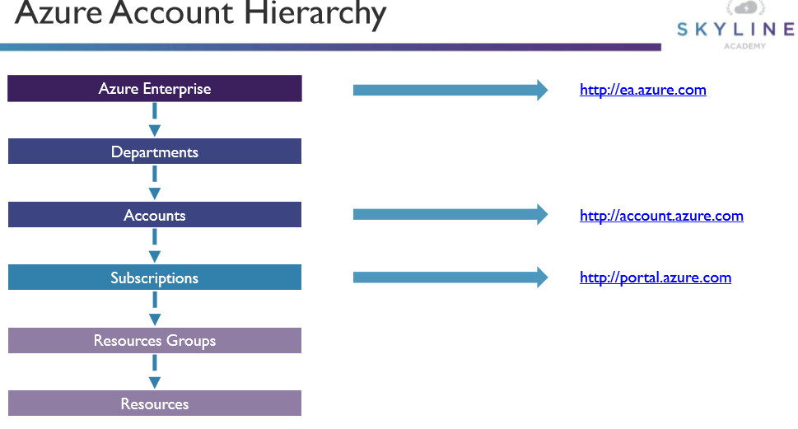
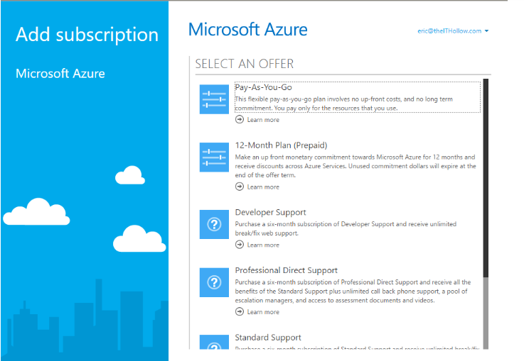
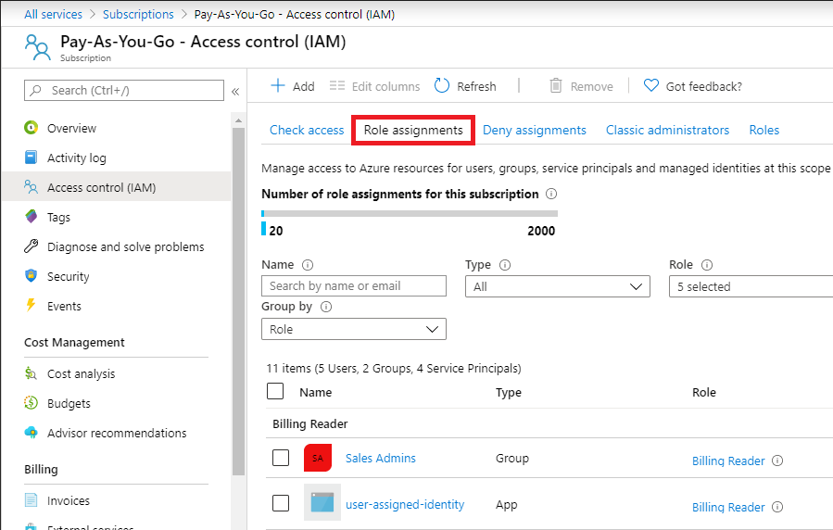
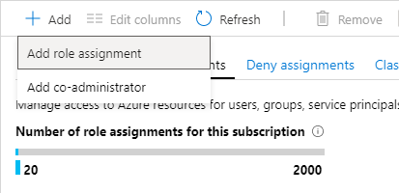

Slide 13
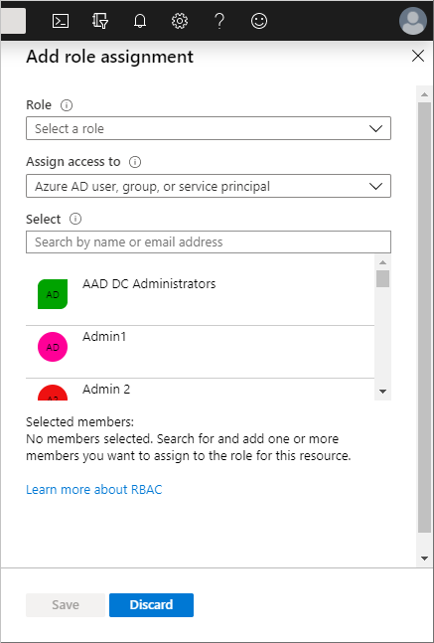
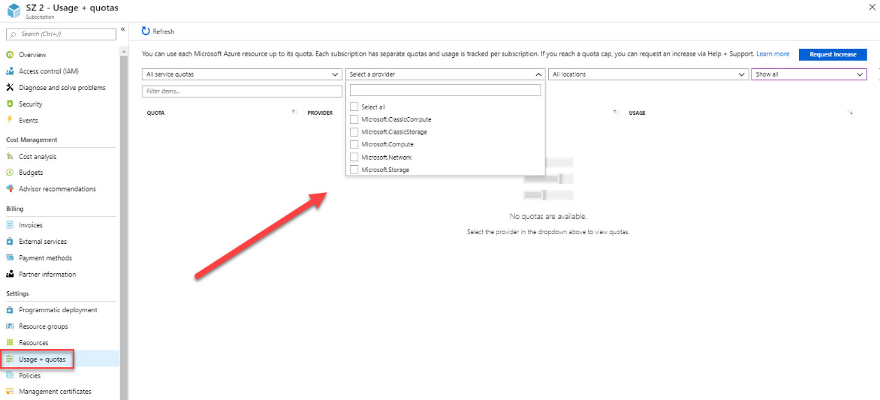
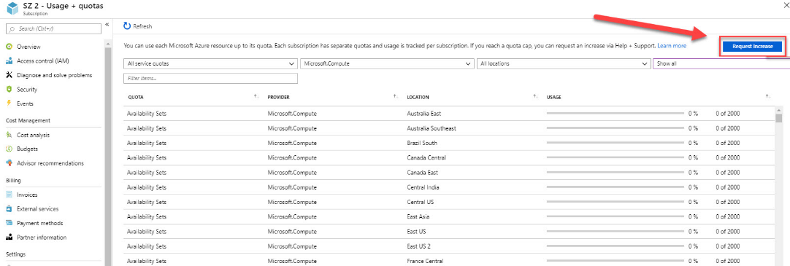

Slide 14
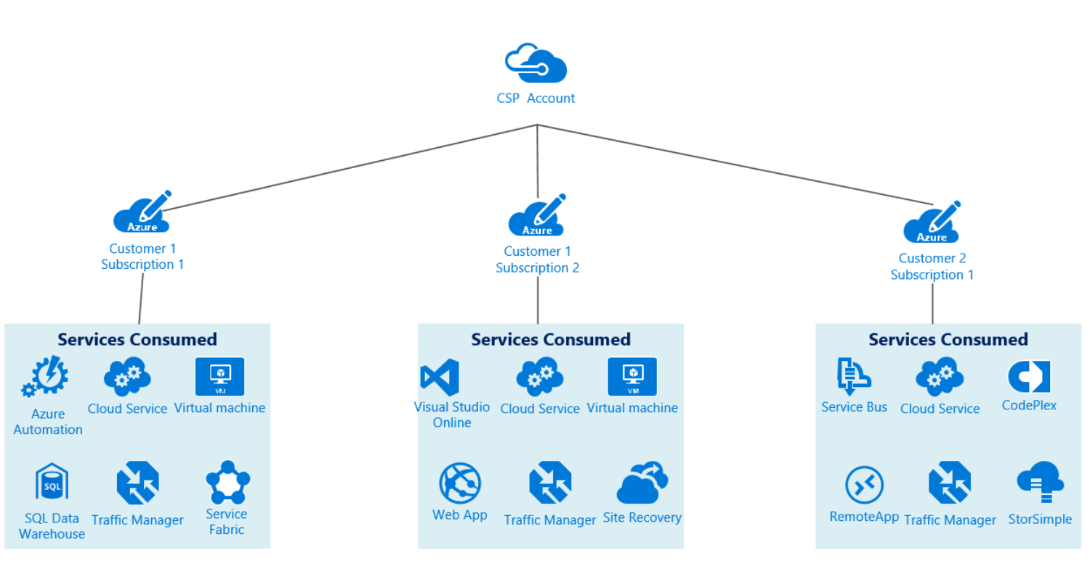
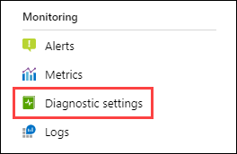
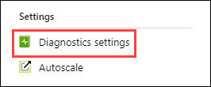
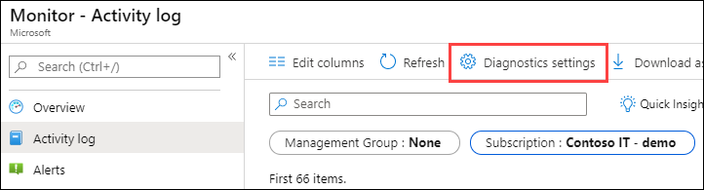
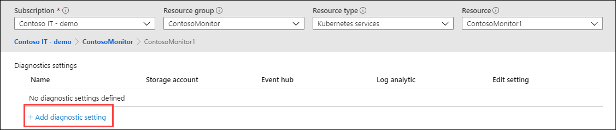

Slide 15
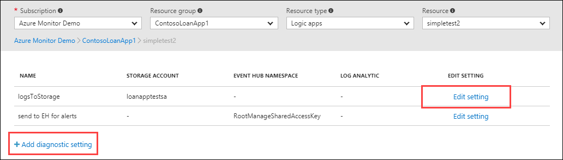
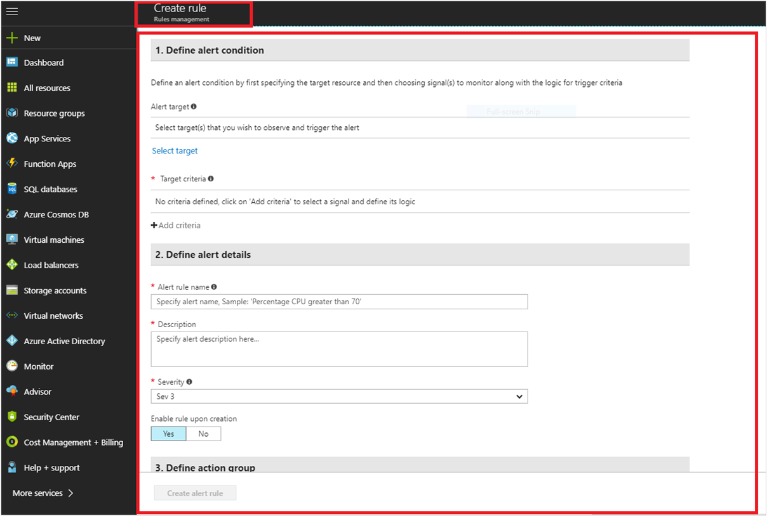
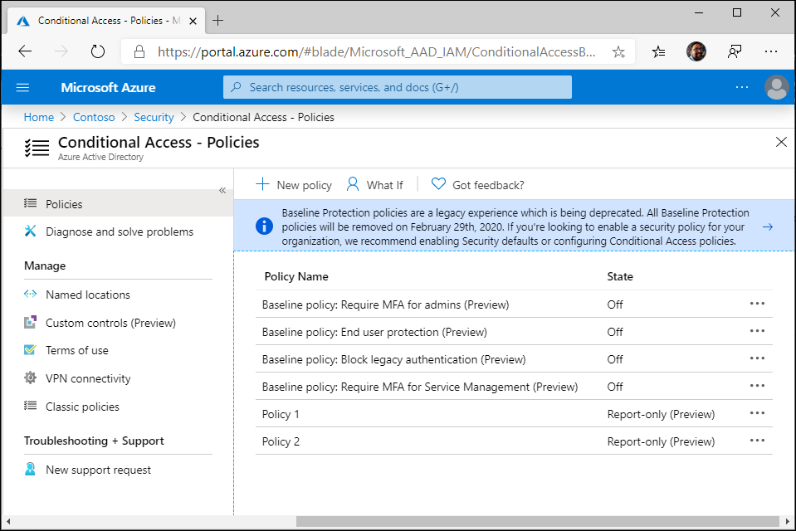

Slide 16
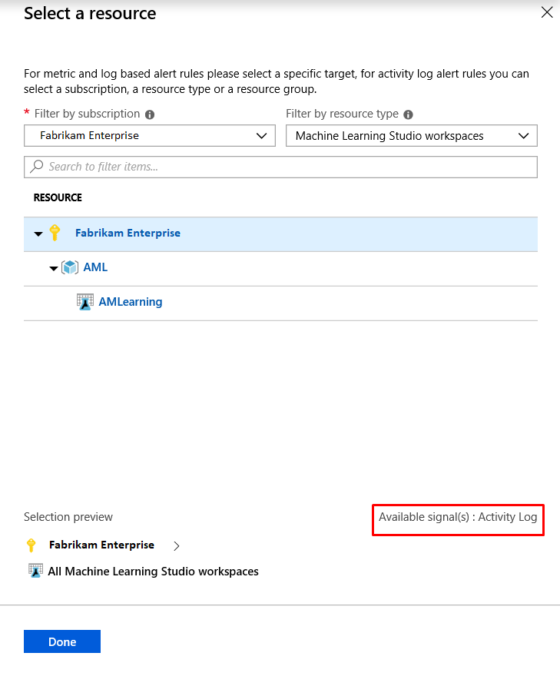
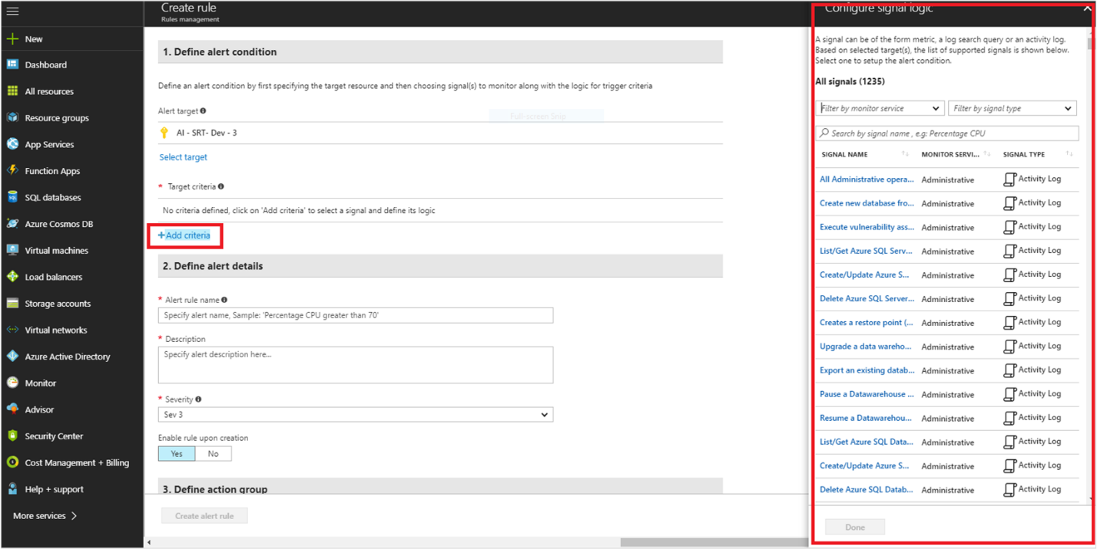
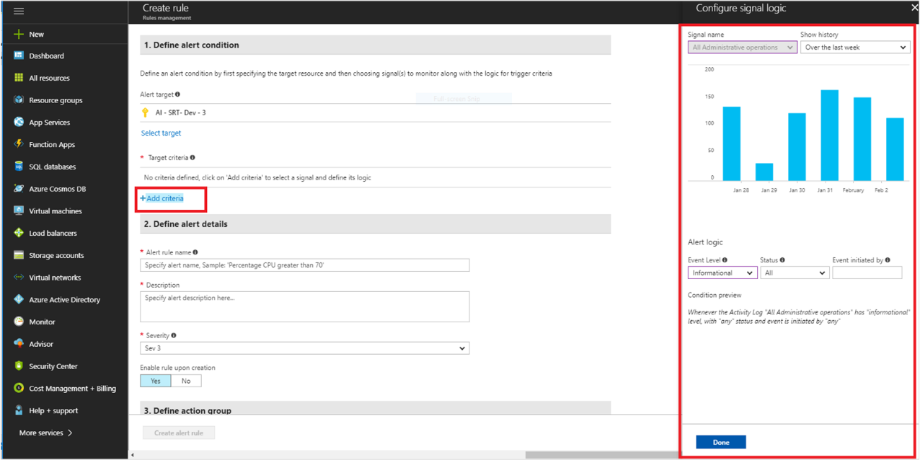

Slide 17
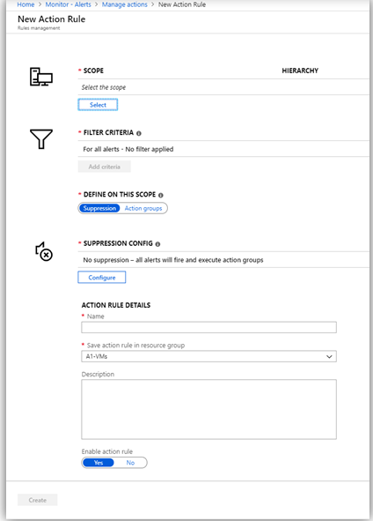
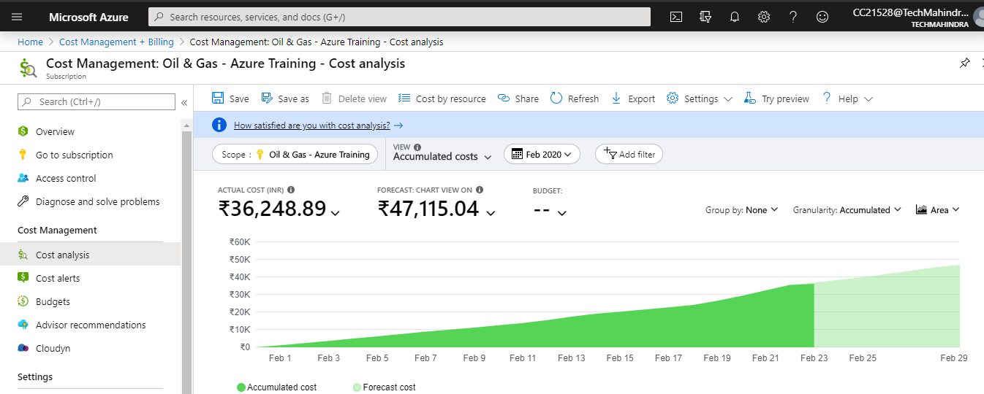
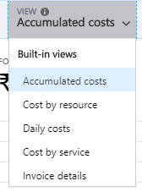
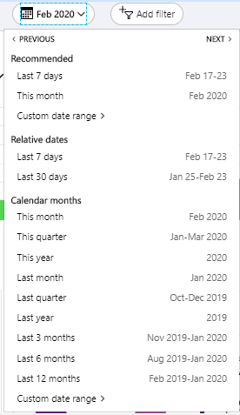
Alert type | Enterprise Agreement | Microsoft Customer Agreement | Web direct/Pay-As-You-Go
Budget | ✔ | ✔ | ✔
Credit | ✔ | ✘ | ✘
Department spending quota | ✔ | ✘ | ✘

Slide 18
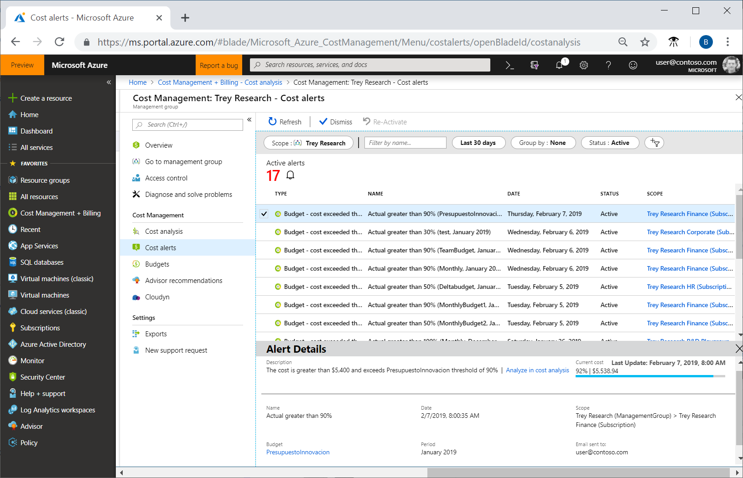
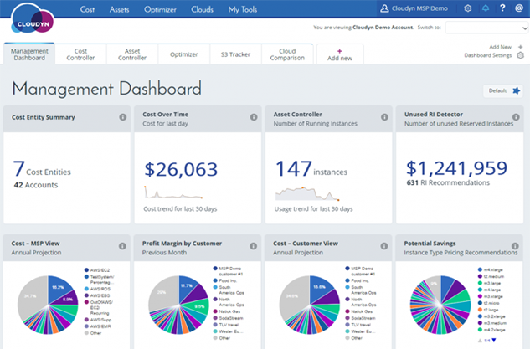
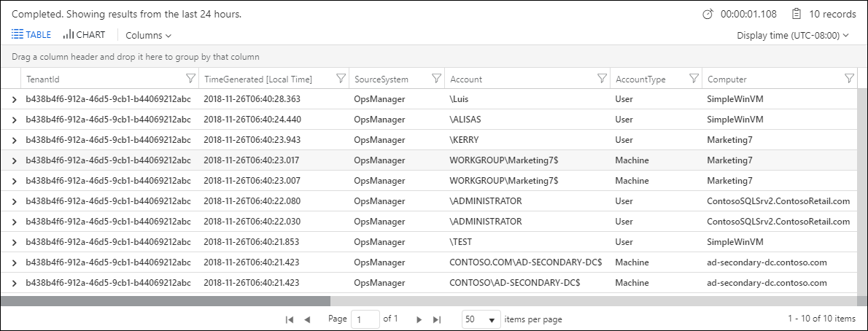

Slide 19
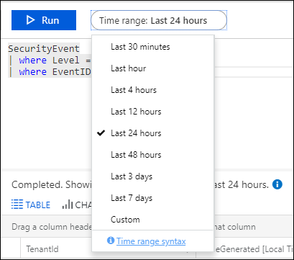
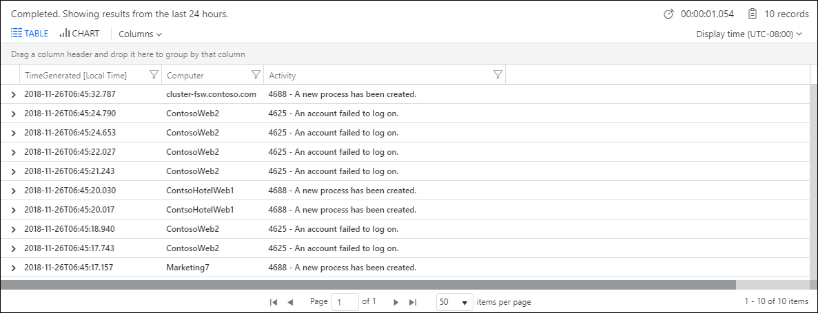
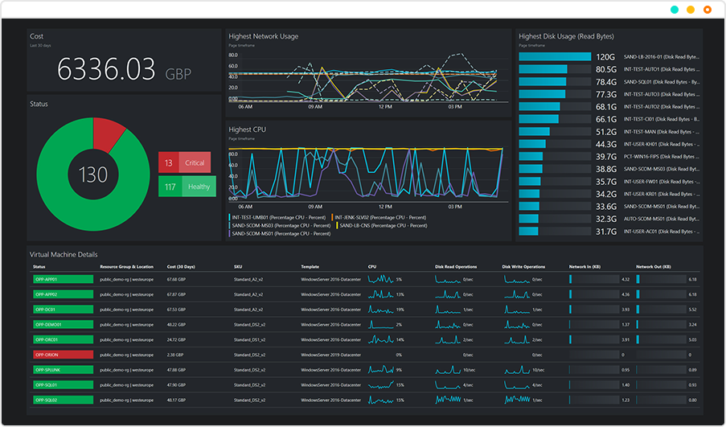
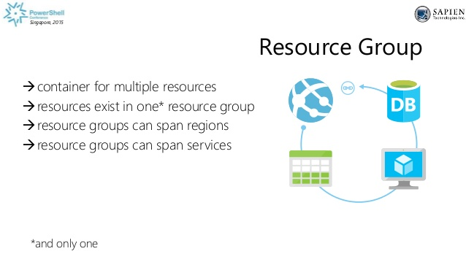

Slide 20
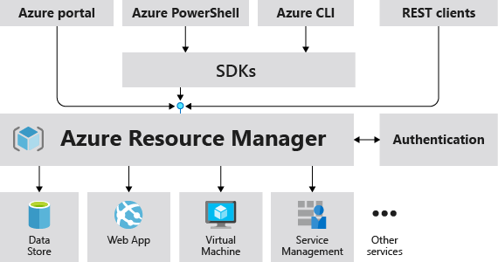
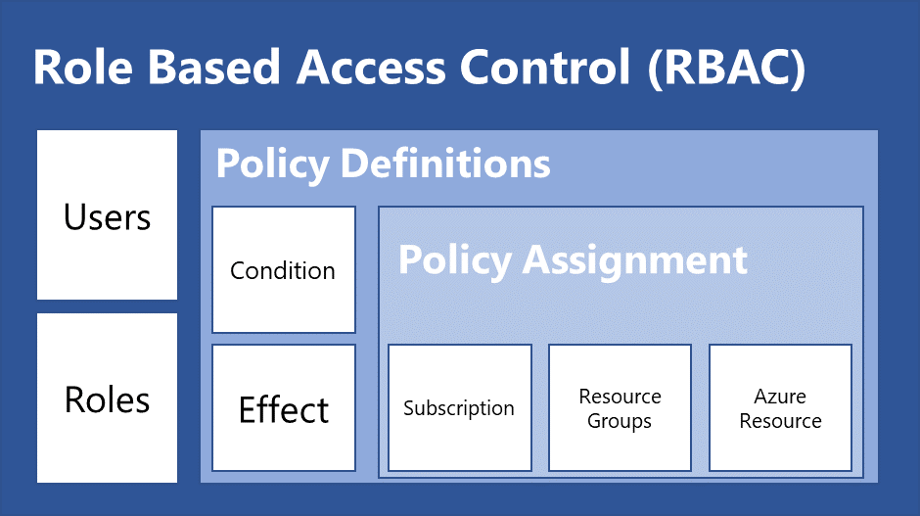
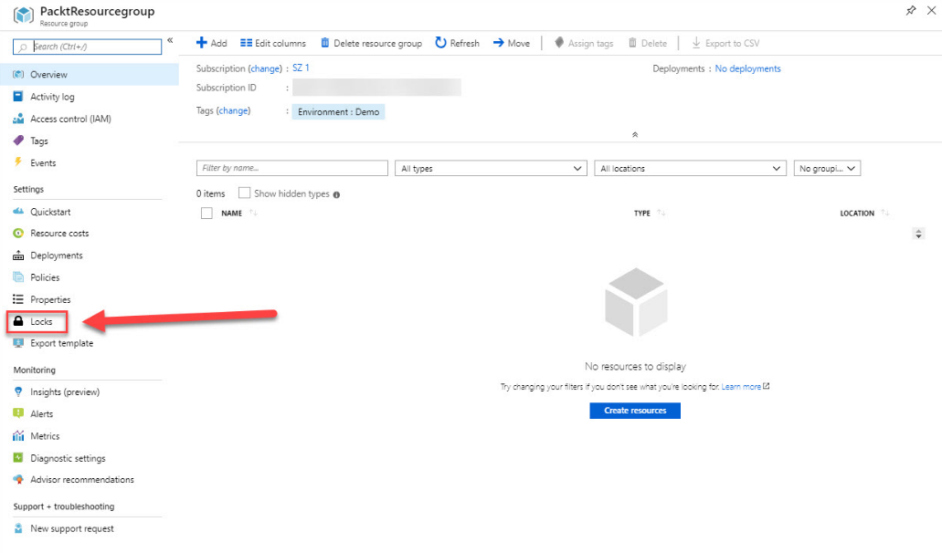
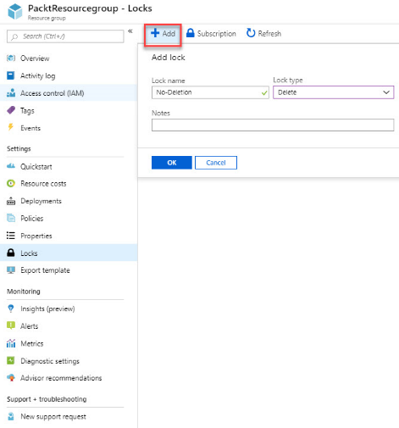

Slide 21
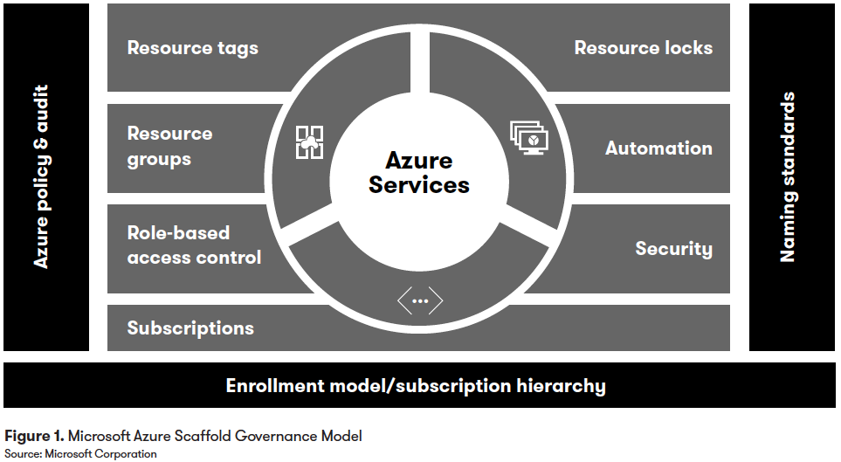
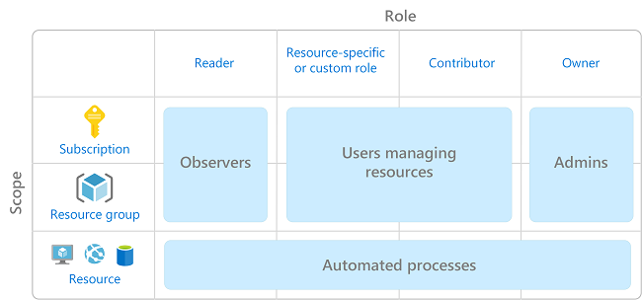
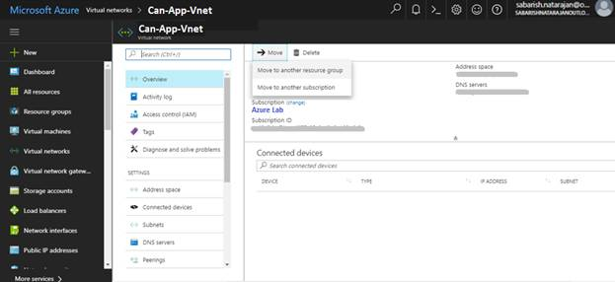

Slide 22
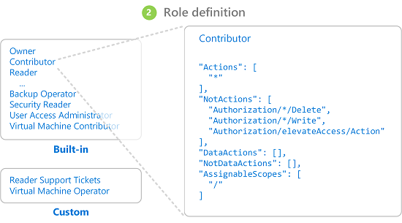
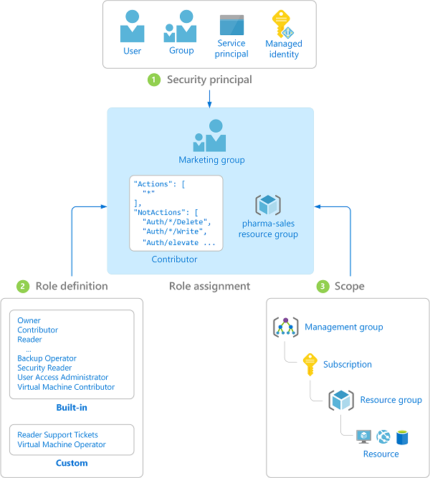
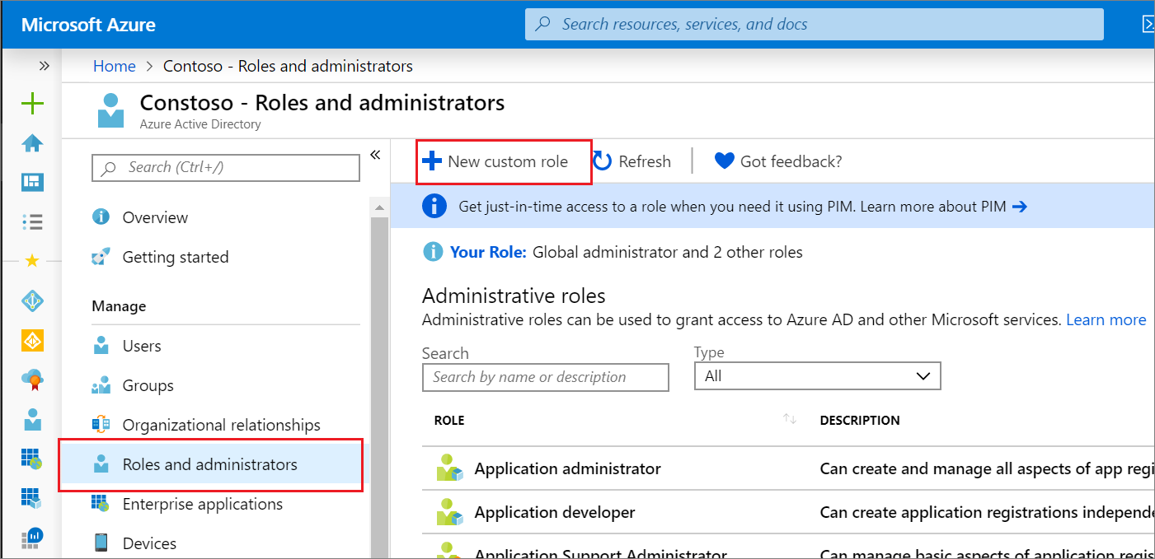

Slide 23
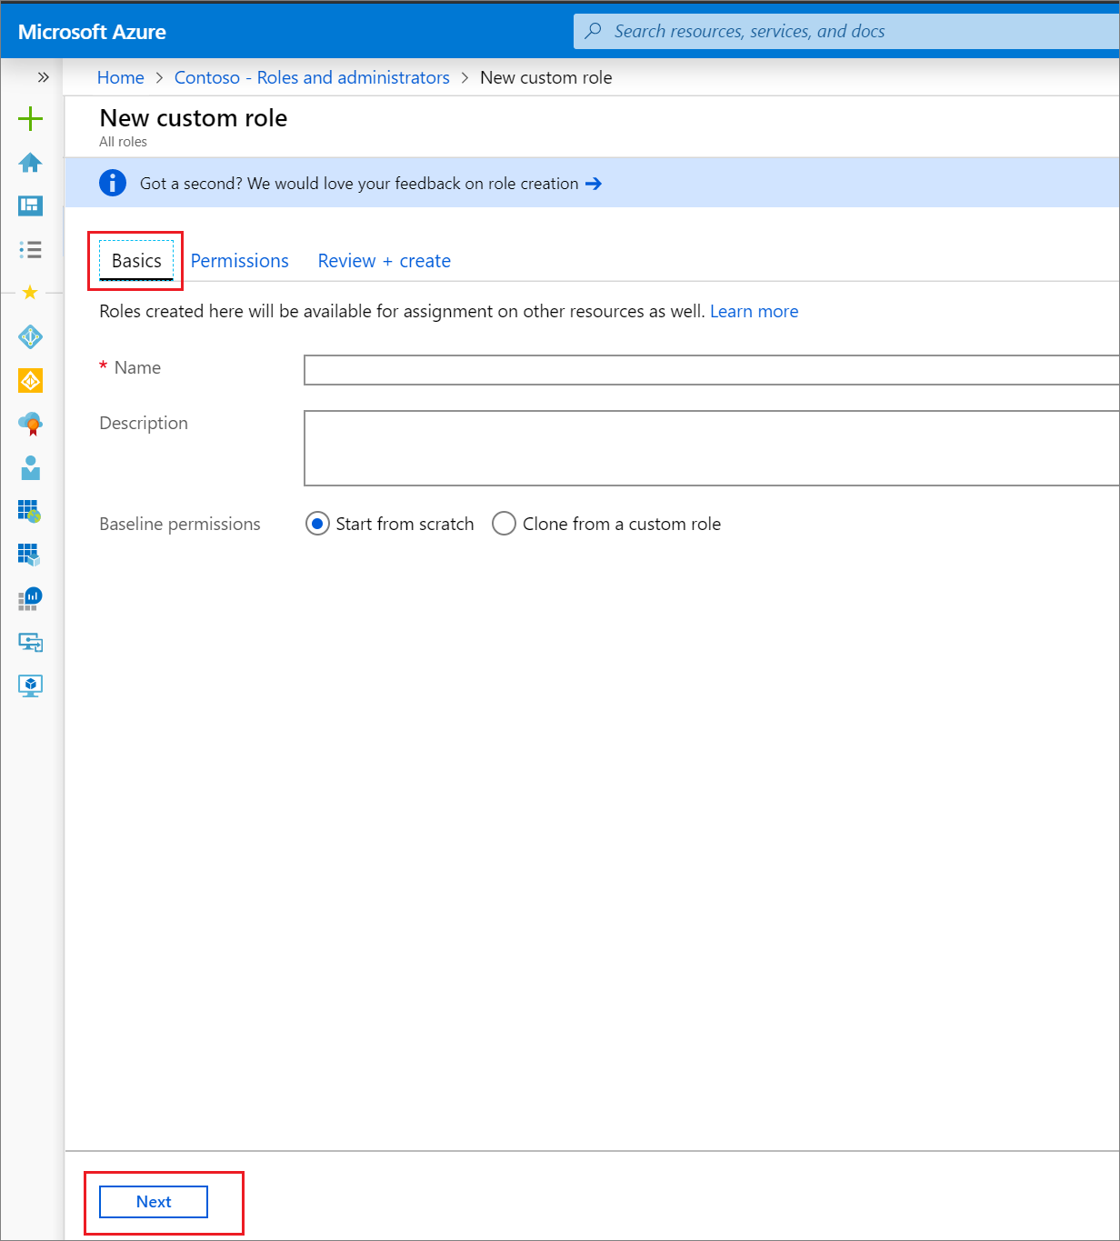
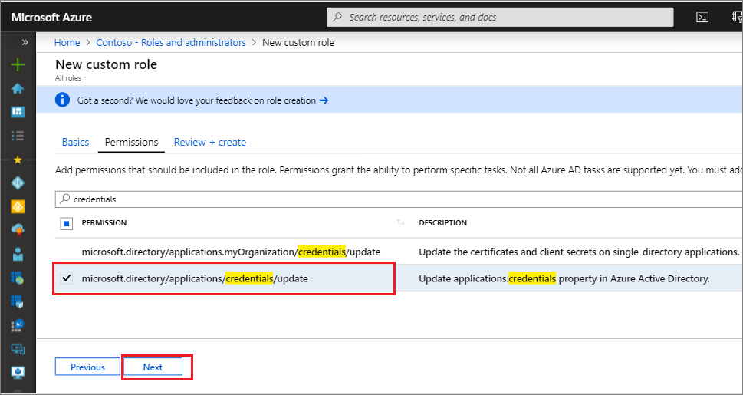

Slide 25
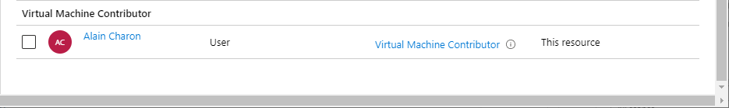
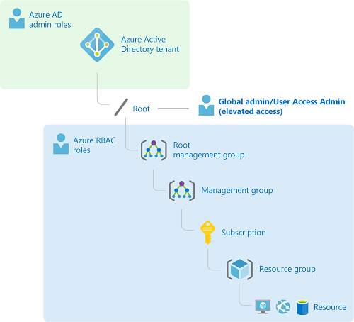
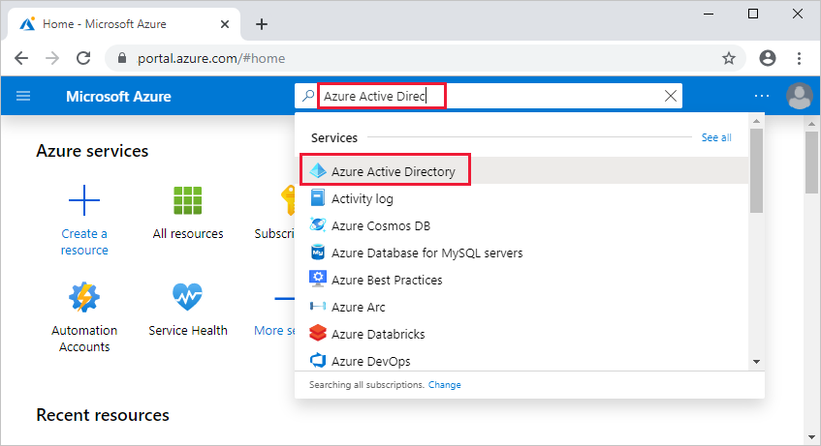

Slide 26
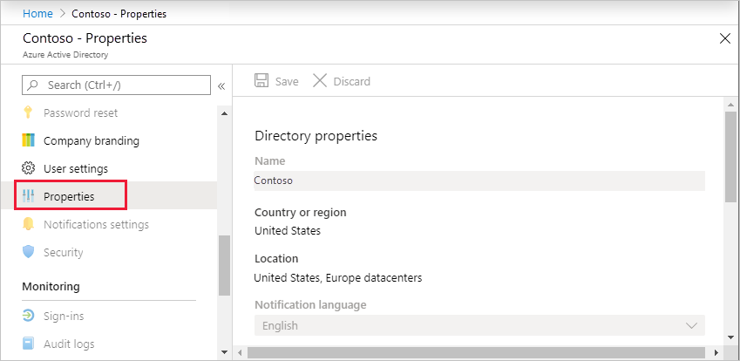
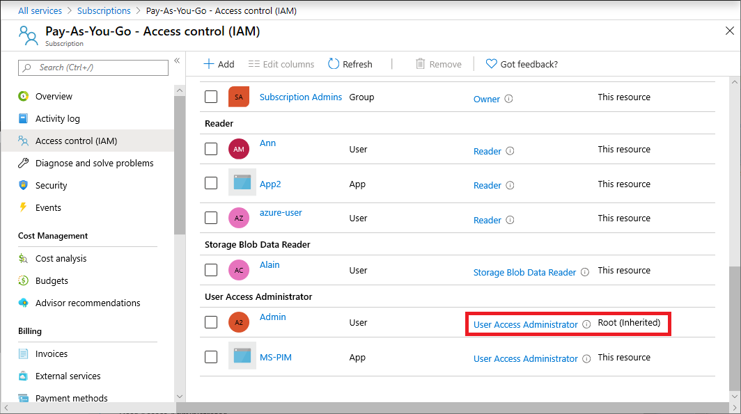
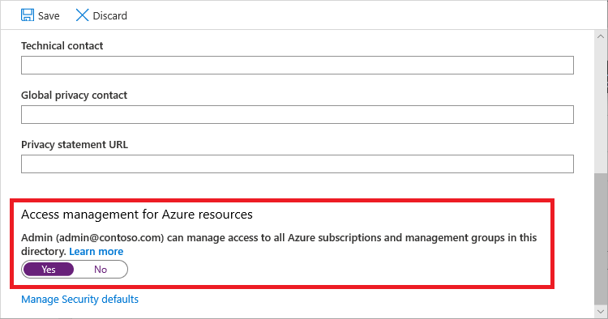

Slide 27
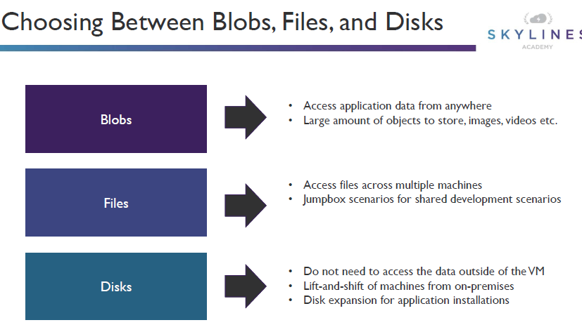
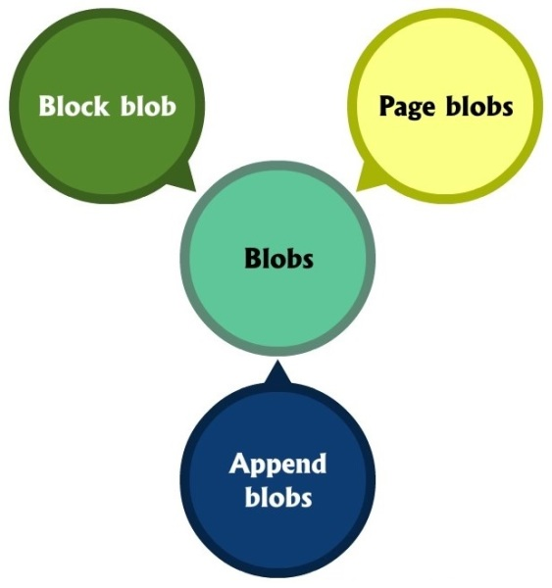
Storage account type | Supported services | Supported performance tiers | Supported access tiers | Replication options | Deployment model ¹ | Encryption ²
General-purpose V2 | Blob, File, Queue, Table, Disk, and Data Lake Gen2 ⁶ | Standard, Premium ⁵ | Hot, Cool, Archive ³ | LRS, GRS, RA-GRS, ZRS, GZRS (preview), RA-GZRS (preview) ⁴ | Resource Manager | Encrypted
General-purpose V1 | Blob, File, Queue, Table, and Disk | Standard, Premium ⁵ | N/A | LRS, GRS, RA-GRS | Resource Manager, Classic | Encrypted
BlockBlobStorage | Blob (block blobs and append blobs only) | Premium | N/A | LRS, ZRS ⁴ | Resource Manager | Encrypted
FileStorage | File only | Premium | N/A | LRS, ZRS ⁴ | Resource Manager | Encrypted
BlobStorage | Blob (block blobs and append blobs only) | Standard | Hot, Cool, Archive ³ | LRS, GRS, RA-GRS | Resource Manager | Encrypted

Slide 28
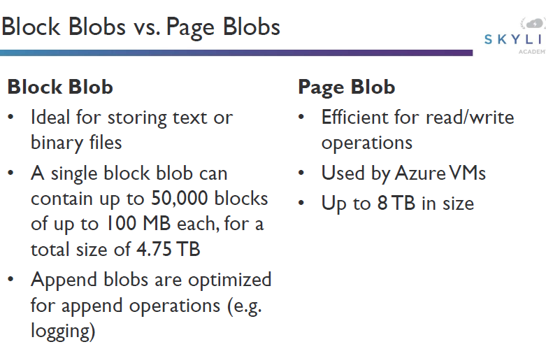



Slide 29






Slide 30




Field | Value
Deployment model | Resource Manager
Performance | Standard
Account kind | StorageV2 (general-purpose v2)
Replication | Read-access geo-redundant storage (RA-GRS)
Access tier | Hot

Slide 31





Slide 32



Slide 33



Slide 34




Slide 35




Slide 36




Slide 37





Slide 38






SIZE OF EACH INSTANCE | AZURE BACKUP PRICE PER MONTH
Instance < or = 50 GB | $5 + storage consumed
Instance is >50 but < or = 500 GB | $10 + storage consumed
Instance > 500 GB | $10 for each 500 GB increment + storage consumed

Slide 39






Slide 40





Slide 41





Slide 42






Slide 43


Category | Managed disks | Unmanaged disks
Management | Is an ARM (Azure Resource Manager) object (resource) | Is not an ARM resource, but a file (.vhd) residing on a Azure Storage Account. The latter is an ARM object
Size | The managed disks sizes are fixed (and can be resized). Which means that you cannot choose a custom size. You will need to pick up from a list. | You can choose the disk size during the provisioning (and can be resized) when using Standard Storage.
Cost | You will pay : · Standard Storage : o A fixed price per disk size (Per month), whatever the disk usage is o Operations cost* · Premium Storage o A fixed price per disk size whatever the disk usage is | You will pay : · Standard Storage : o The GB / month disk usage. You pay only what you consume o Operations cost* · Premium Storage o A fixed price per disk size whatever the disk usage is
Performance | A managed disk have a predictable performance, with Standard storage (500 IOPS) or Premium storage (Depends on the disk). | Only premium storage disks have a predictable performance (depends on the disk). Standard storage have a predictable performance (500 IOPS) unless they are impacted by the Storage Account performance limits (A maximum of 40 disks per standard storage account is recommended, otherwise disks can be throttled).
Availability | When placing VMs using managed disks under an Availability Set, disks are placed on different fault domains in order to achieve the better SLA (The Availability Set SLA is only for compute) | When placing VMs using unmanaged disks under an Availability Set, there is no guarantee that the disks are placed on different fault domains, even if they are on different Storage Accounts.
Redundancy | LRS | LRS, GRS
Encryption | ADE, SSE (Coming soon) | ADE, SSE

Slide 44




Scenario | Manual group of VMs | Virtual machine scale set
Add additional VM instances | Manual process to create, configure, and ensure compliance | Automatically create from central configuration
Traffic balancing and distribution | Manual process to create and configure Azure load balancer or Application Gateway | Can automatically create and integrate with Azure load balancer or Application Gateway
High availability and redundancy | Manually create Availability Set or distribute and track VMs across Availability Zones | Automatic distribution of VM instances across Availability Zones or Availability Sets
Scaling of VMs | Manual monitoring and Azure Automation | Autoscale based on host metrics, in-guest metrics, Application Insights, or schedule

Slide 45



Element name | Required | Description
parameter-name | Yes | Name of the parameter. Must be a valid JavaScript identifier.
type | Yes | Type of the parameter value. The allowed types and values are string, securestring, int, bool, object, secureObject, and array. See Data types.
defaultValue | No | Default value for the parameter, if no value is provided for the parameter.
allowedValues | No | Array of allowed values for the parameter to make sure that the right value is provided.
minValue | No | The minimum value for int type parameters, this value is inclusive.
maxValue | No | The maximum value for int type parameters, this value is inclusive.
minLength | No | The minimum length for string, secure string, and array type parameters, this value is inclusive.
maxLength | No | The maximum length for string, secure string, and array type parameters, this value is inclusive.
description | No | Description of the parameter that is displayed to users through the portal. For more information, see Comments in templates.

Slide 46
Element name | Required | Description
$schema | Yesa | Location of the JSON schema file that describes the version of the template language. For resource group deployments, use: https://schema.management.azure.com/schemas/2015-01-01/deploymentTemplate.json# For subscription deployments, use: https://schema.management.azure.com/schemas/2018-05-01/subscriptionDeploymentTemplate.json#
contentVersion | Yes | Version of the template (such as 1.0.0.0). You can provide any value for this element. Use this value to document significant changes in your template. When deploying resources using the template, this value can be used to make sure that the right template is being used.
apiProfile | No | An API version that serves as a collection of API versions for resource types. Use this value to avoid having to specify API versions for each resource in the template. When you specify an API profile version and don't specify an API version for the resource type, Resource Manager uses the API version for that resource type that is defined in the profile. The API profile property is especially helpful when deploying a template to different environments, such as Azure Stack and global Azure. Use the API profile version to make sure your template automatically uses versions that are supported in both environments. For a list of the current API profile versions and the resources API versions defined in the profile, see API Profile. For more information, see Track versions using API profiles.
parameters | No | Values that are provided when deployment is executed to customize resource deployment.
variables | No | Values that are used as JSON fragments in the template to simplify template language expressions.
functions | No | User-defined functions that are available within the template.
resources | Yes | Resource types that are deployed or updated in a resource group or subscription.
outputs | No | Values that are returned after deployment.

Slide 47



eography | Paired regions
Asia | East Asia | Southeast Asia
Australia | Australia East | Australia Southeast
Australia | Australia Central | Australia Central 2
Brazil | Brazil South | South Central US
Canada | Canada Central | Canada East
China | China North | China East
China | China North 2 | China East 2
Europe | North Europe (Ireland) | West Europe (Netherlands)
France | France Central | France South
Germany | Germany Central | Germany Northeast
India | Central India | South India
India | West India | South India
Japan | Japan East | Japan West
Korea | Korea Central | Korea South
North America | East US | West US
North America | East US 2 | Central US
North America | North Central US | South Central US
North America | West US 2 | West Central US
South Africa | South Africa North | South Africa West
UK | UK West | UK South
United Arab Emirates | UAE North | UAE Central
US Department of Defense | US DoD East | US DoD Central
US Government | US Gov Arizona | US Gov Texas
US Government | US Gov Iowa | US Gov Virginia
US Government | US Gov Virginia | US Gov Texas

Slide 48






Slide 49



Slide 50




Slide 51



IPV4 | 172.16.0.0
IPV6 Compressed: | ::ffff:ac10:0
IPV6 Expanded (Shortened): | 0:0:0:0:0:ffff:ac10:0
IPV6 Expanded: | 0000:0000:0000:0000:0000:ffff:ac10:0000
Address | Mask | Addresses |  | Example | Allotted
format |  | IP Address | 2^{n} | Address Format | IP Addresses
 |  | Count
a.b.c.d/32 | 255.255.255.255 | 1 | 20 | 172.16.0.0/32 | 172.16.0.0
a.b.c.d/31 | 255.255.255.254 | 2 | 21 | 172.16.0.0/31 | 172.16.0.0
 |  |  |  |  | 172.16.0.1
a.b.c.d/30 | 255.255.255.252 | 4 | 22 | 172.16.0.0/30 | 172.16.0.0
 |  |  |  |  | 172.16.0.1
 |  |  |  |  | 172.16.0.2
 |  |  |  |  | 172.16.0.3
a.b.c.d/29 | 255.255.255.248 | 8 | 23 | 172.16.0.0/29 | 172.16.0.0
 |  |  |  |  | 172.16.0.1
 |  |  |  |  | 172.16.0.2
 |  |  |  |  | 172.16.0.3
 |  |  |  |  | 172.16.0.4
 |  |  |  |  | 172.16.0.5
 |  |  |  |  | 172.16.0.6
 |  |  |  |  | 172.16.0.7
Addresses continue until 2³² = 4,294,967,296

Slide 52


Azure reserves 5 IP addresses within each subnet. These are x.x.x.0-x.x.x.3 and the last address of the subnet. x.x.x.1-x.x.x.3 is reserved in each subnet for Azure services.
x.x.x.0: Network address
x.x.x.1: Reserved by Azure for the default gateway
x.x.x.2, x.x.x.3: Reserved by Azure to map the Azure DNS IPs to the VNet space
x.x.x.255: Network broadcast address

Slide 53
Resource | Default/maximum limit
Virtual networks | 1,000
Subnets per virtual network | 3,000
Virtual network peerings per virtual network | 500
Virtual network gateways (VPN gateways) per virtual network | 1
Virtual network gateways (ExpressRoute gateways) per virtual network | 1
DNS servers per virtual network | 20
Private IP addresses per virtual network | 65,536
Private IP addresses per network interface | 256
Private IP addresses per virtual machine | 256
Public IP addresses per network interface | 256
Public IP addresses per virtual machine | 256
Concurrent TCP or UDP flows per NIC of a virtual machine or role instance | 500,000
Network interface cards | 65,536
Network Security Groups | 5,000
NSG rules per NSG | 1,000
IP addresses and ranges specified for source or destination in a security group | 4,000
Application security groups | 3,000
Application security groups per IP configuration, per NIC | 20
IP configurations per application security group | 4,000
Application security groups that can be specified within all security rules of a network security group | 100
User-defined route tables | 200
User-defined routes per route table | 400
Point-to-site root certificates per Azure VPN Gateway | 20
Virtual network TAPs | 100
Network interface TAP configurations per virtual network TAP | 100

Slide 54





Slide 55





Slide 56





Slide 57







Slide 58




Slide 59






Slide 60





Slide 61




Slide 62




Slide 63





Slide 64





Slide 65







Slide 66





Slide 67




Slide 68





Slide 69

Additional task | Description
Privacy Settings | View what telemetry data is being shared with Microsoft.
View current configuration | View your current Azure AD Connect solution. This includes general settings, synchronized directories, and sync settings.
Customize synchronization options | Change the current configuration like adding additional Active Directory forests to the configuration, or enabling sync options such as user, group, device, or password write-back.
Configure device options | Device options available for synchronization
Refresh directory schema | Allows you to add new on-premises directory objects for synchronization
Configure Staging Mode | Stage information that is not immediately synchronized and is not exported to Azure AD or on-premises Active Directory. With this feature, you can preview the synchronizations before they occur.
Change user sign-in | Change the authentication method users are using to sign-in
Manage federation | Manage your AD FS infrastructure, renew certificates, and add AD FS servers
Troubleshoot | Help with troubleshooting Azure AD Connect issues

Slide 70





